Slide 1
The Use of Feature Films in English Language Training for Seafarers
Svitlana Korieshkova, PhD
Ukraine State University of Infrastructure and Technologies

Slide 2
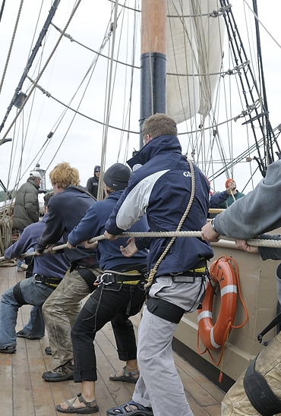
Desired Outcomes
Creative thinking;
Teamwork and cooperation;
Preparation for extreme situations;
Mastering the language of international communication

Slide 3
Expect The Unexpected
Preparing to face life-or-death situations
Superior planning
Good facilities
Excellent training

Slide 4
Watch and Learn
Development of the professional and communication skills;
Increase of students’ abilities to understand the viewing material;
Expand the vocabulary;
Learn how to express a point of view;
Distinguish the main idea and principal points of a movie.

Slide 5
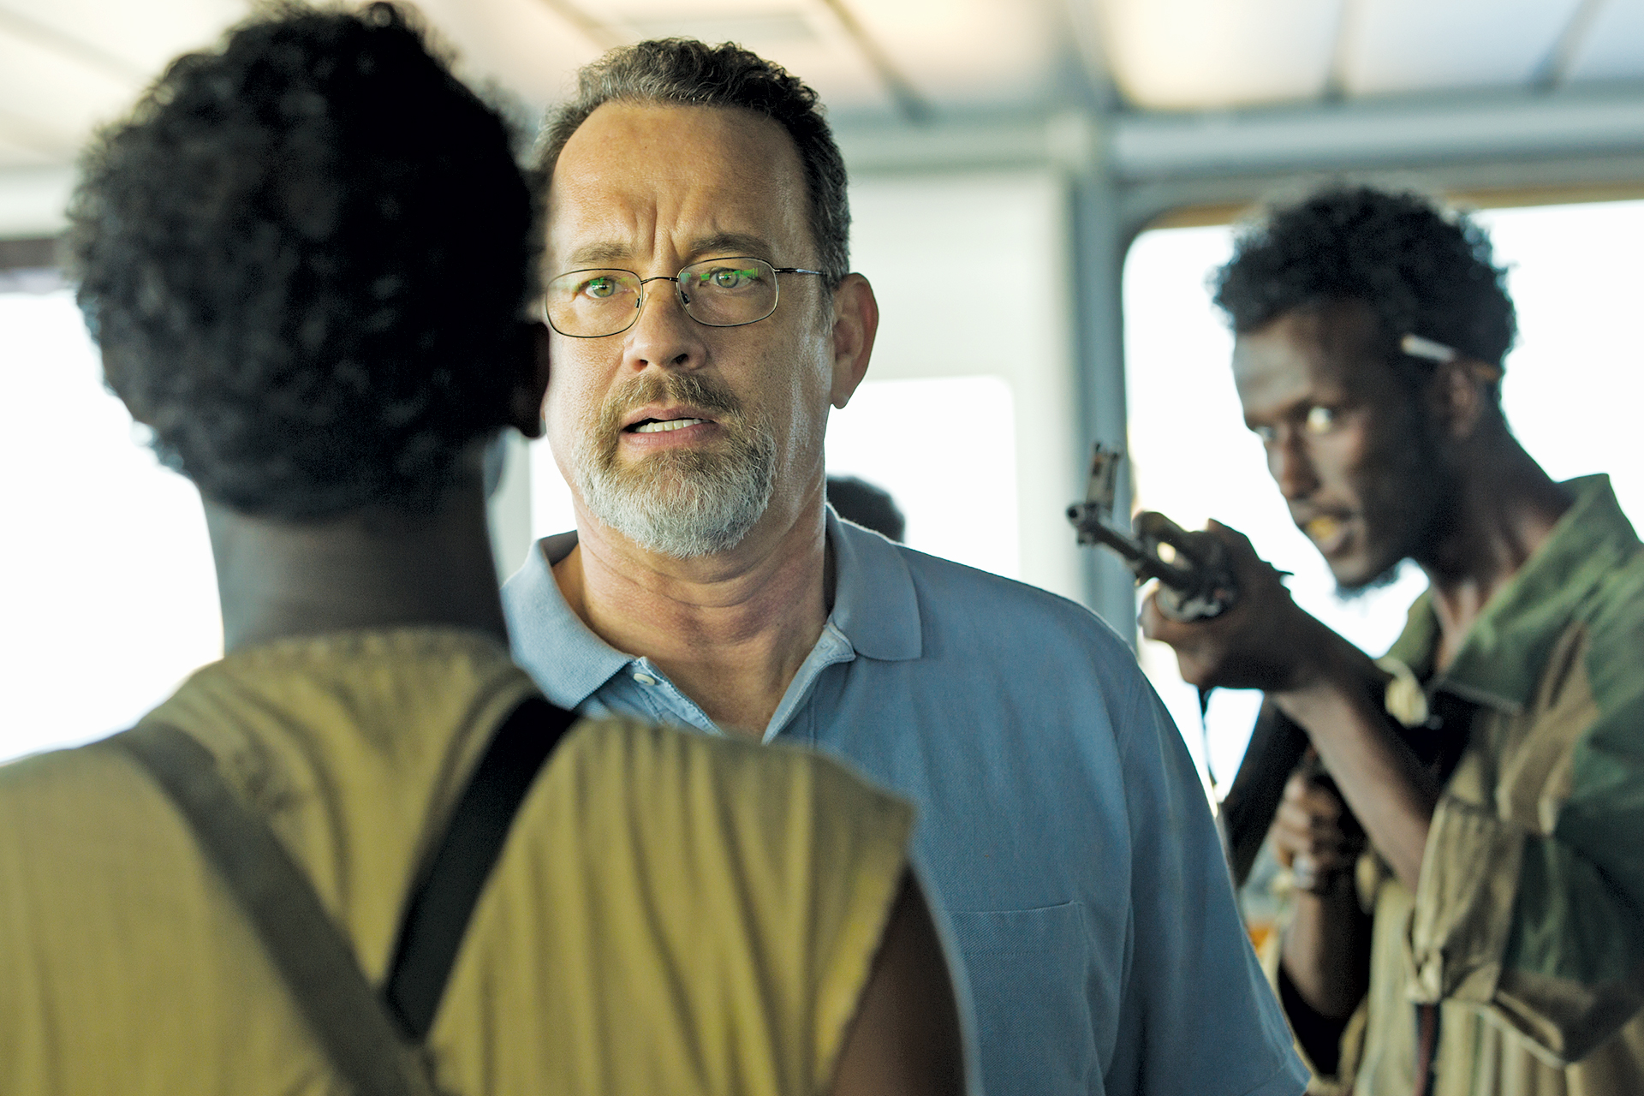
Safety First
Communication between the rescuer and the rescued;
Teamwork is essential;
Safety is every crew member’s duty.

Slide 6

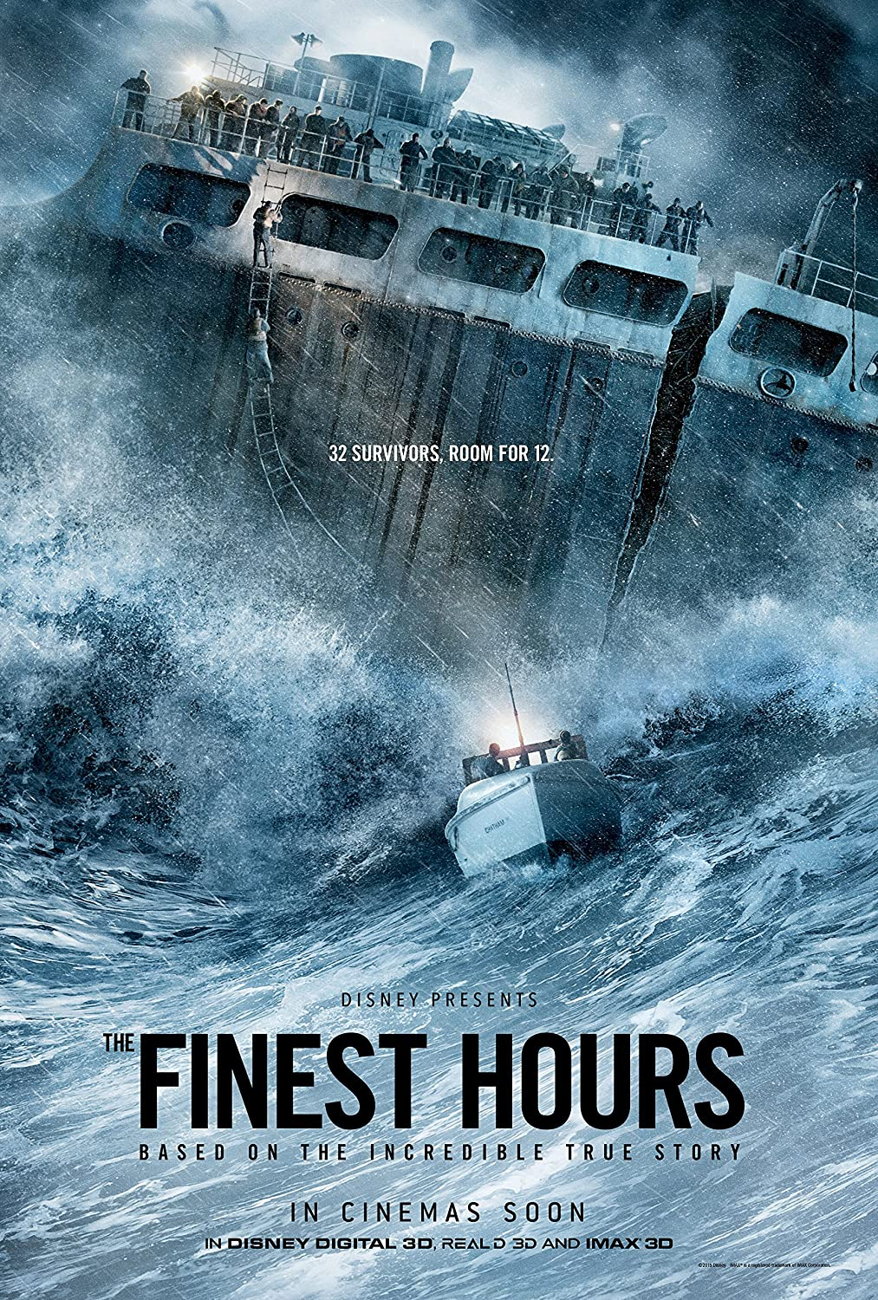
Extreme Situations
Man Overboard
Fire onboard
Abandoning the vessel
Pirate attack
SAR (search and rescue operation)

Slide 7

Exercises Based on Captain Phillips
Practicing vocabulary;
Behavior analysis in extreme work situations at sea;
Group discussion;
Written assignment.

Slide 8

Conclusion
- motivating and enjoyable;
- provide authentic and varied language;
- give a visual context;
- variety and flexibility;
- effective means of professional-personal development.

